Slide 1


Big Data Statistics
Efthymios Ioannis Kavour

Slide 2


Table of Content
Dimension Reduction and Big Data Statistics
Big Data Regression
Usage of Machine Learning on Big Data

Slide 3
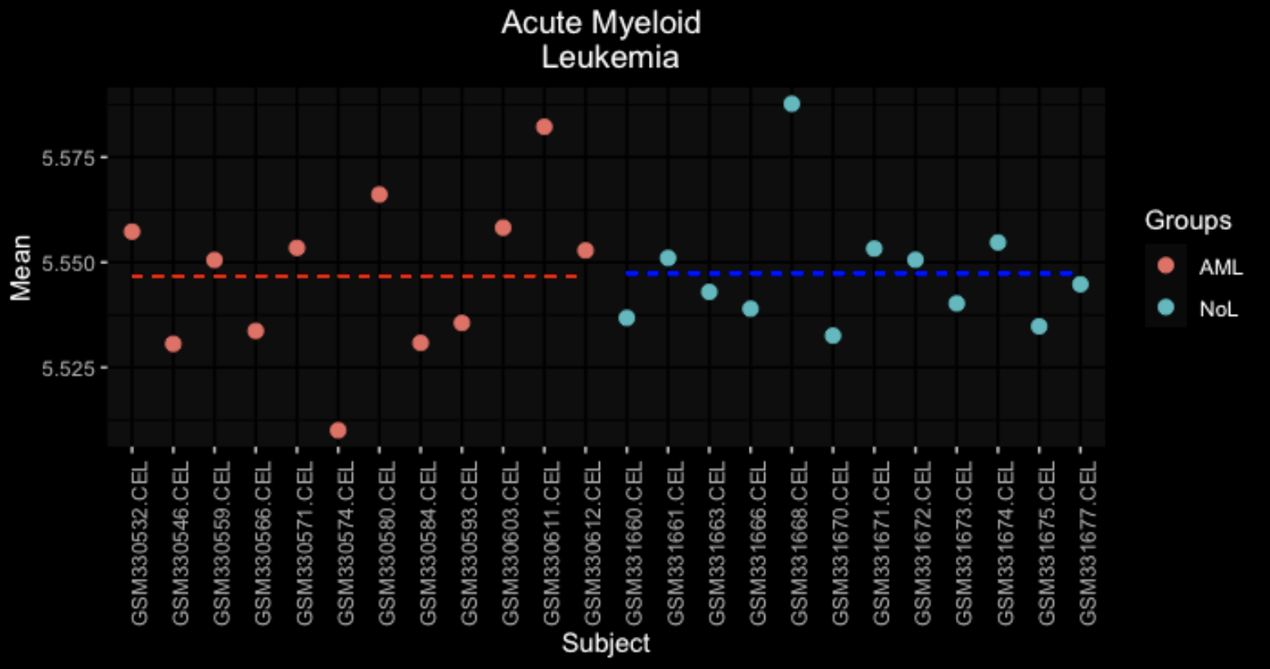
Dimension Reduction and Big Data Statistics
20172 x 24
Working with big data is a challenging topic. Conventional Statistics either will not work or it will consume a lot of resources (inc. time).
24 samples =
24 dimensions =
24 problems…

Slide 4
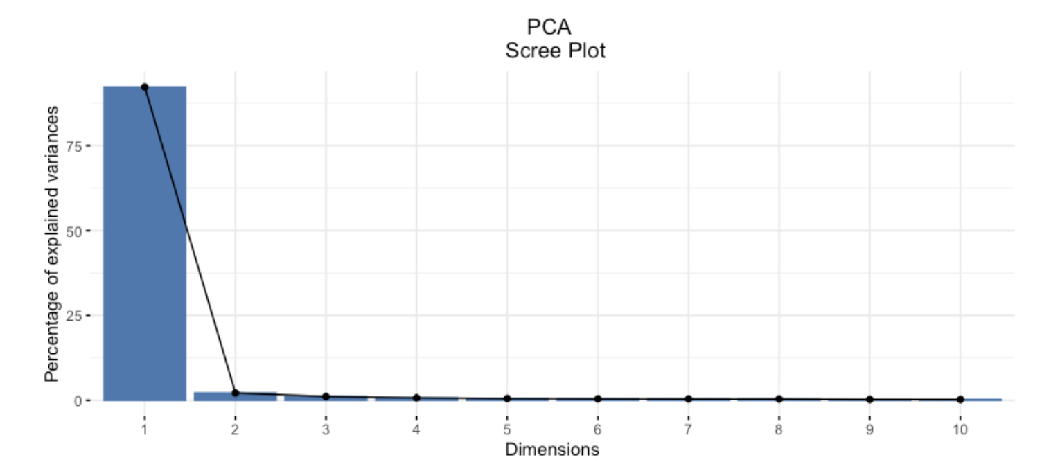
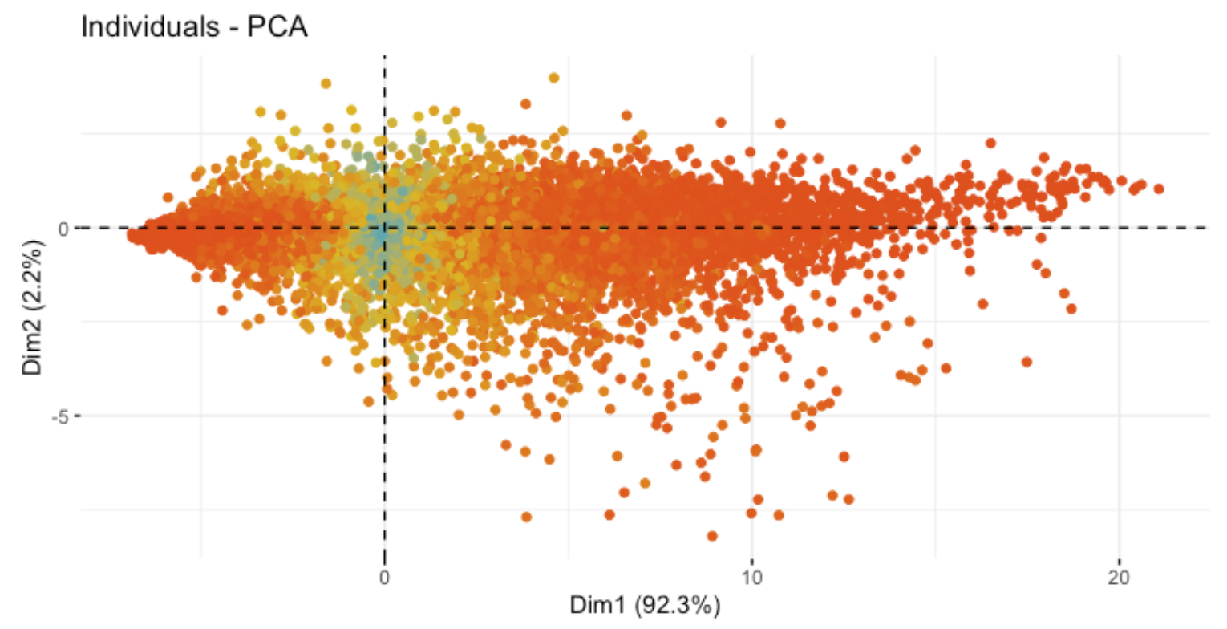
Dimension Reduction and Big Data Statistics
Principal Component Analysis is our solution.
92.3 % of data variance are explained by the first PC whereas 2.2 % of by the second PC.

Slide 5
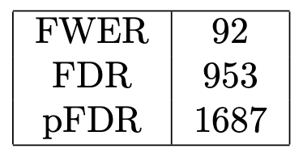
Dimension Reduction and Big Data Statistics
But what about Hypothesis testing?
But the significant level is as usual right?
One can apply multiple hypothesis testing
Unfortunately not, action need to be taken!
Multiple test hypothesis need some adjustments.
q_value is a solution
q_value is the minimum FDR and allow us simultaneous check of multiple results.
Benjamini Hochberg
Bonferonni
Holm
Hochberg

Slide 6
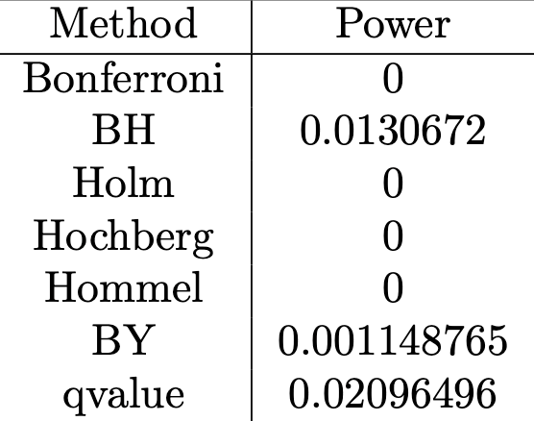
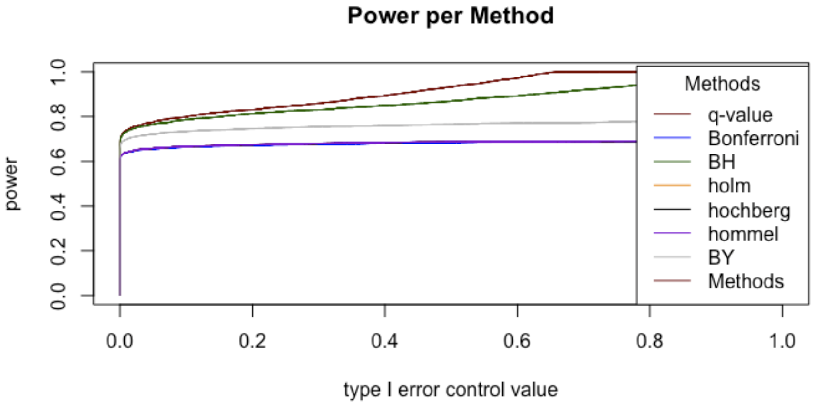
Dimension Reduction and Big Data Statistics
How to choose the right one?
In order to compare the different methods we use power a measurement of the proportion of Non-True that are decleared significant to the total True significant observations.

Slide 7
Big Data Regression
Regression analysis is a powerful statistical technique used to understand and model the relationship between variables. In the context of big data, regression analysis plays a crucial role in extracting insights and making predictions.
The
lm + update
Way
The
matrix $(X^{T}X)^{-1}X^{T}Y$
way

Slide 8
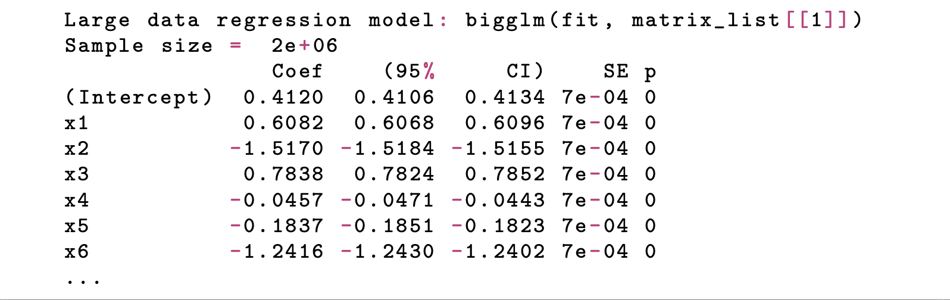
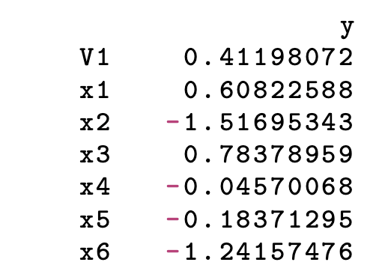
Big Data Regression
The
lm + update
Way
The
Matrix
Way
=

Slide 9
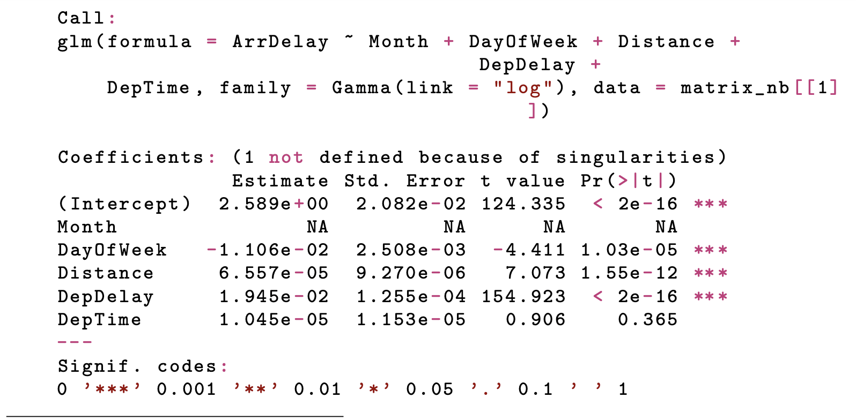
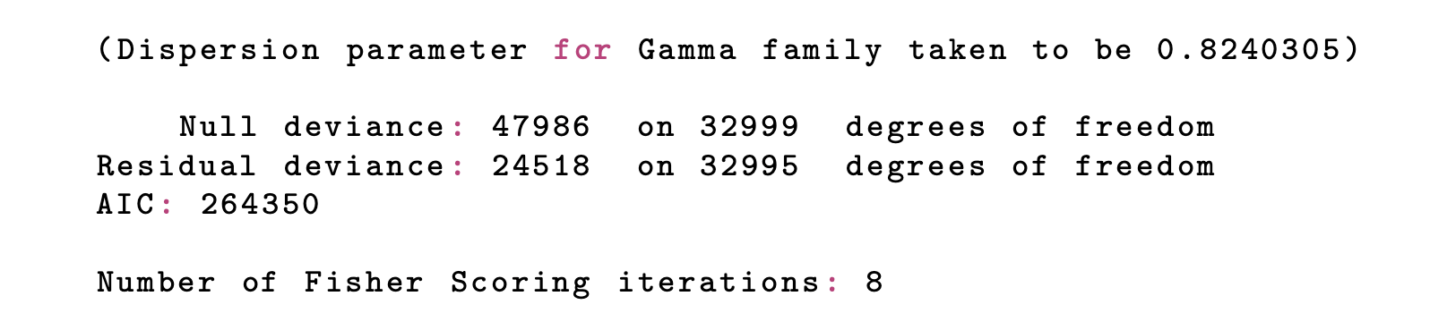
Big Data Regression
Airline dataset Model.
7129270x29 => 3018442 x6
glm model using gamma family
for loop with update

Slide 10
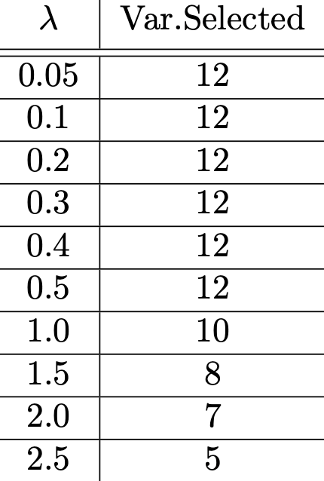
Big Data Regression
There are other methods that can help us select features from big data. One of which is lasso.
We used lasso to pick the select the most useful features.
GOAL:
$$minimize\overset{n}{\underset{i=1}{∑}}(Y_{i}-\overset{p}{\underset{j=1}{∑}}X_{ij}β_{j})^{2}+λ\overset{p}{\underset{j=1}{∑}}|β_{j}|$$

Slide 11
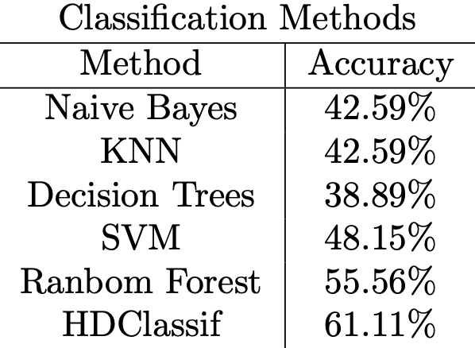
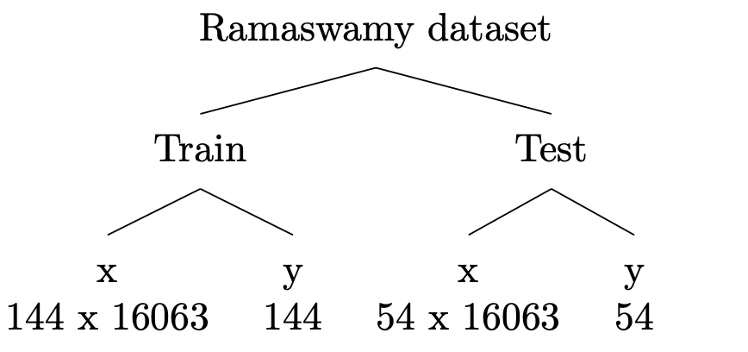
Machine Learning using Big Data
Classification ML on gene data

Slide 12
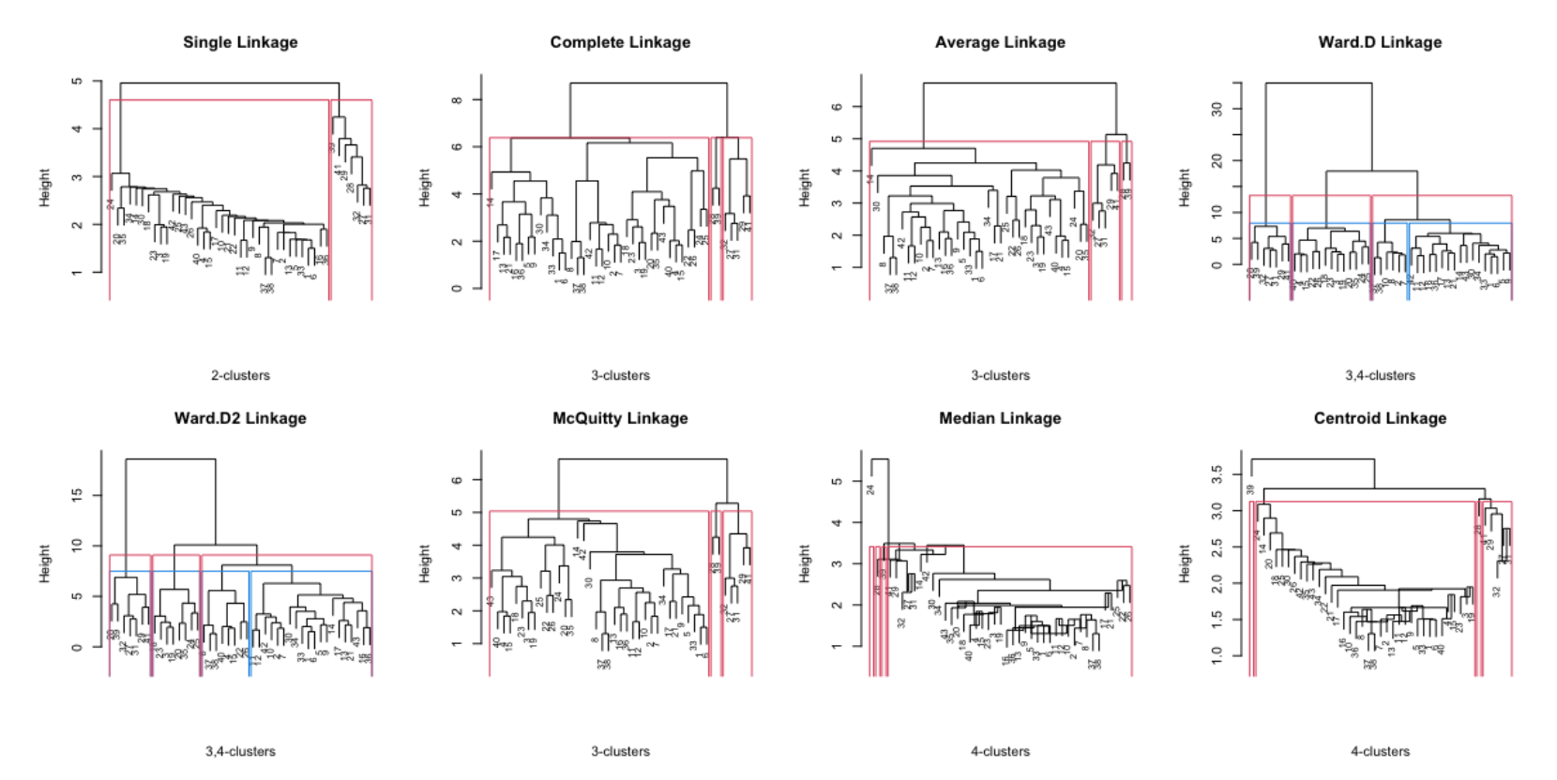
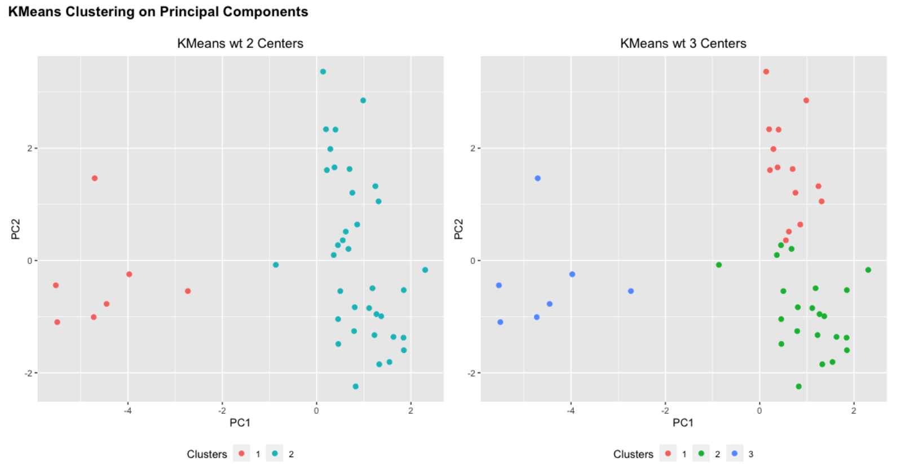
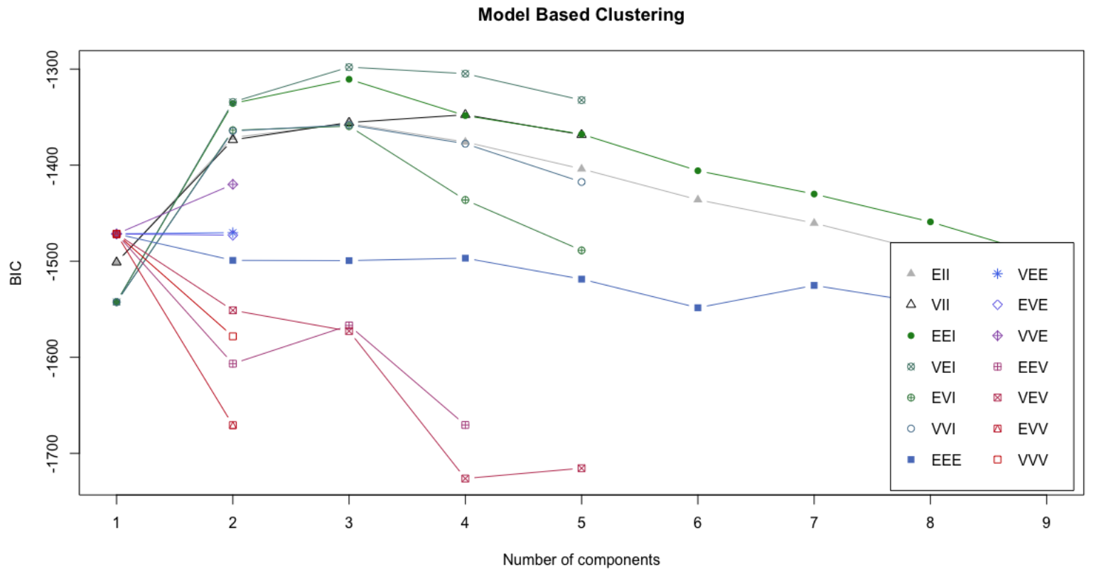
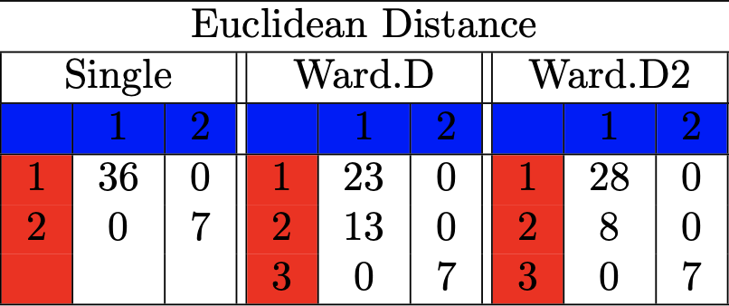
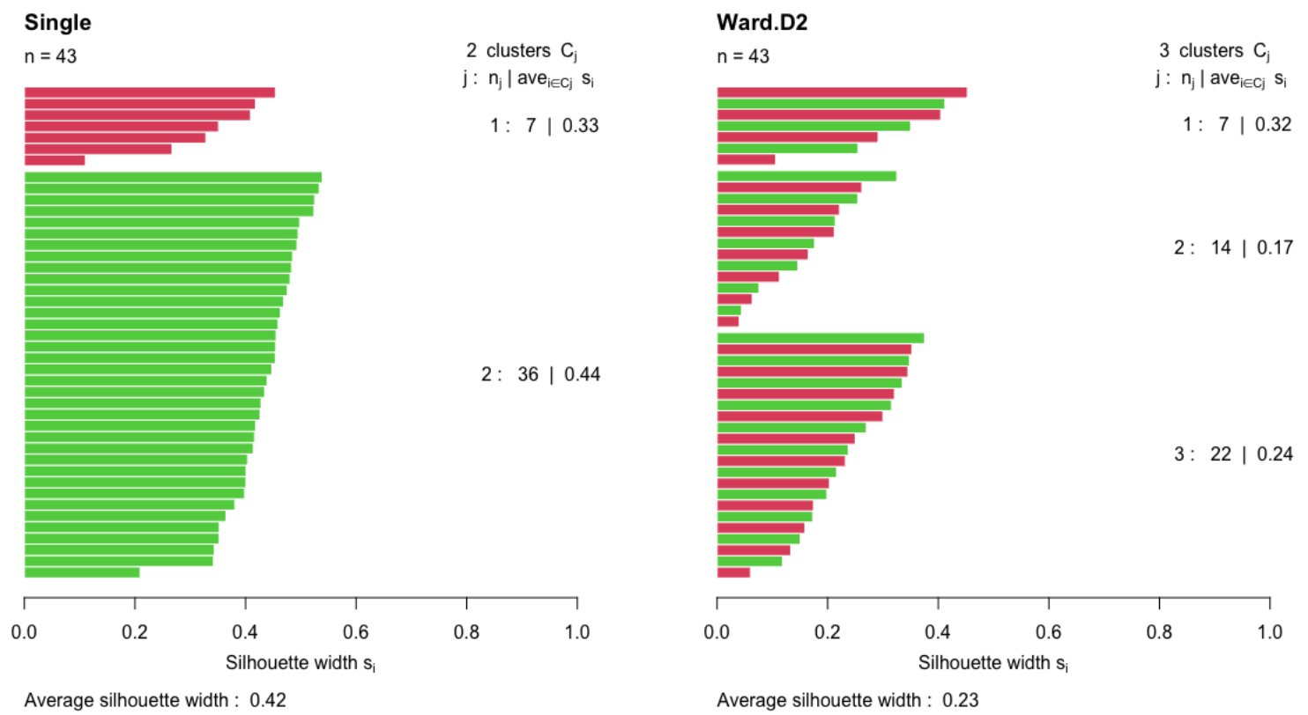
Machine Learning using Big Data
Clustering ML of delicious coffee
1) Hierarchical Clustering
2) K-Means Clustering
3) Model Based Clustering

Slide 13
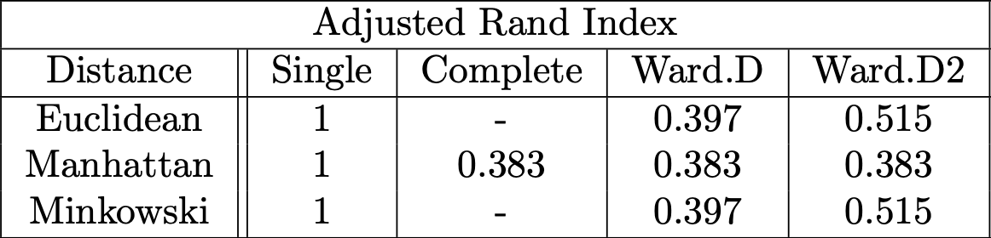
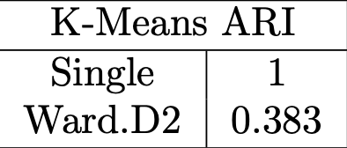
Machine Learning using Big Data
Which one is the best, though?
Adjusted Rand Index (ARI)
$$\text{ARI}=\frac{(\text{agreement})-(\text{expected agreement due to chance})}{(\text{max agreement})-(\text{expected agreement due to chance})}$$

Slide 14
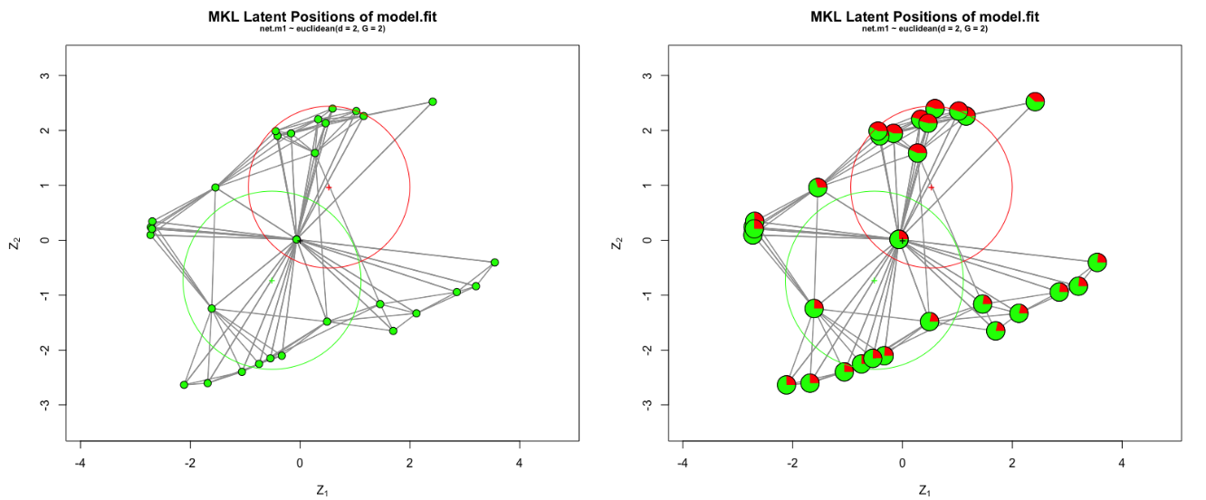
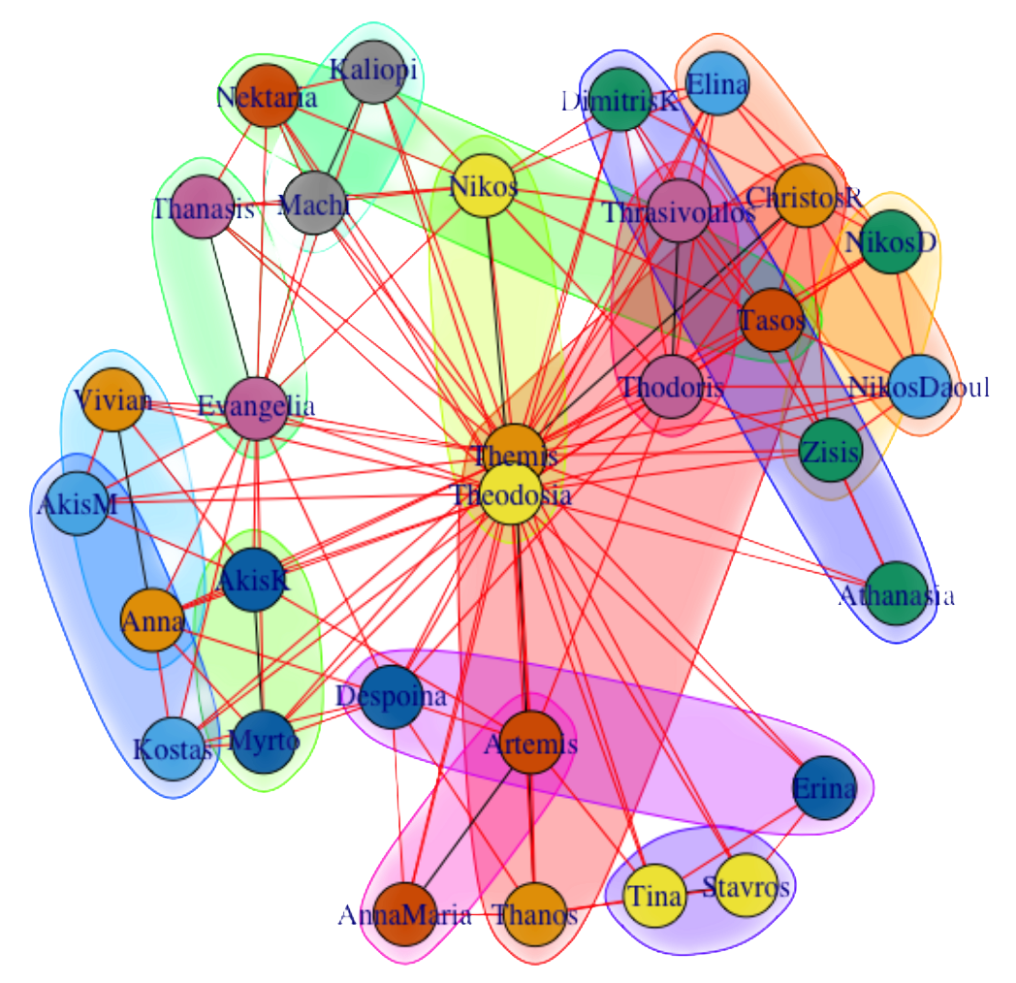
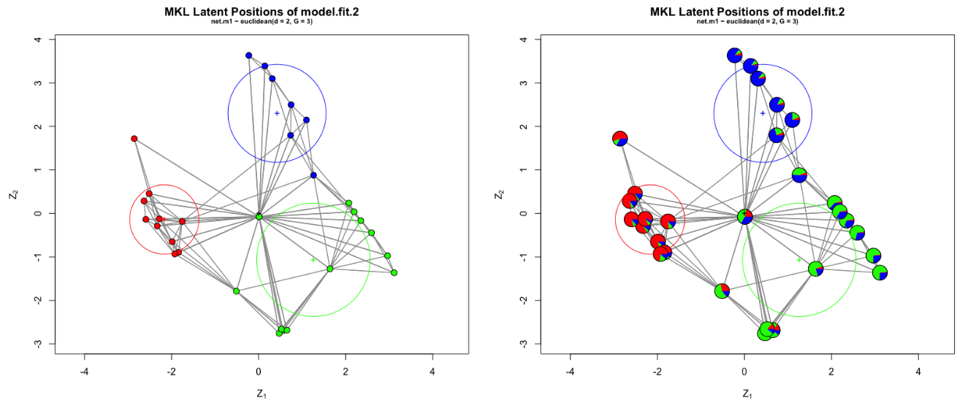
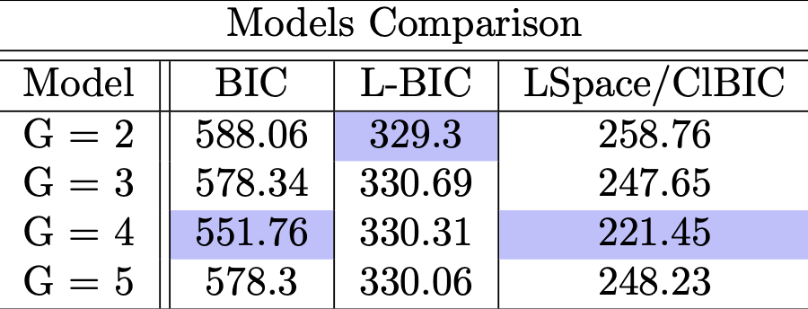
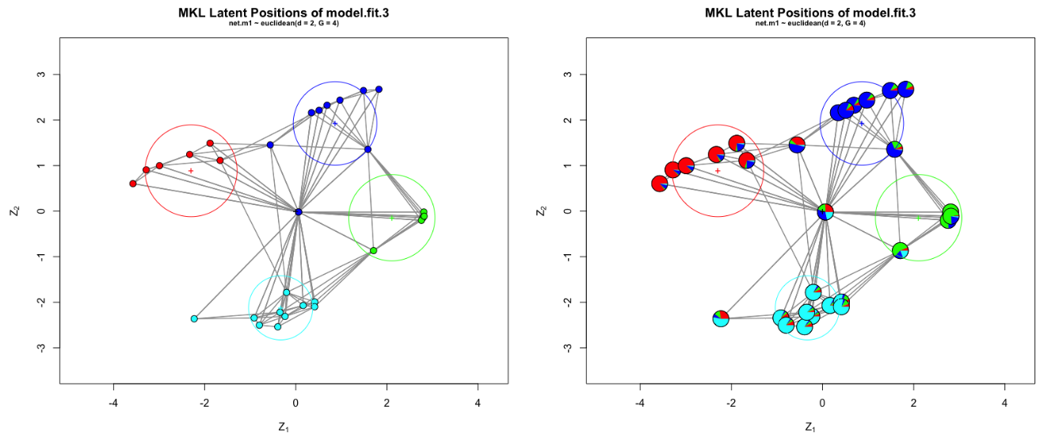
Machine Learning using Big Data
With friends, at last!

